Slide 1
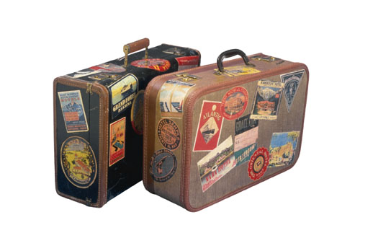
Luggage packing
The picture’s source[1]
Group 130: Christian O’Keeffe, Kasper Plejdrup, Dag Pedersen, Niels Brømdum, Rasmus Gadensgaard, Mette Thomsen and Aleksander Nilsson
Notes:
Mette

Slide 2
Disposition
Problem analyses
The program
Thesis statement
Theory
Bin packing problem
Design
Specification requirements
Solution selection
Program planning
Future plans
Team work
Notes:
Mette

Slide 3
Problem analyses
The problem
Luggage packing
Limits for luggage
Different transportation methods
Exiting solution
None specific for this problem
Notes:
Aleksander

Slide 4
Problem analyses
Thesis statement:
“Is it possible to develop a program that helps the customer through the progress of packing one or more suitcases the most effective way?”
Sub statements
Used for describing the problem
Notes:
Aleksander

Slide 5

Theory
Bin packing problem
Different kinds of packing solutions (fittings)
Initial problem see figure 1
Figure 1: Representing an unsorted luggage list , source [2]
Notes:
Rasmus

Slide 6


Theory
Example of 2 algorithms e.g. First fit and best fit, see figure 2 and 3
Figure 2: Representing the first fit (FF) algorithm, source [2]
Figure 3: Representing the best fit (BF) algorithm, source [2]
Notes:
Rasmus

Slide 7
Design
Specification requirements
Targeted features
Optional features
Purpose
Problem selection
Solution purpose
Choice of solution
Notes:
Christian

Slide 8
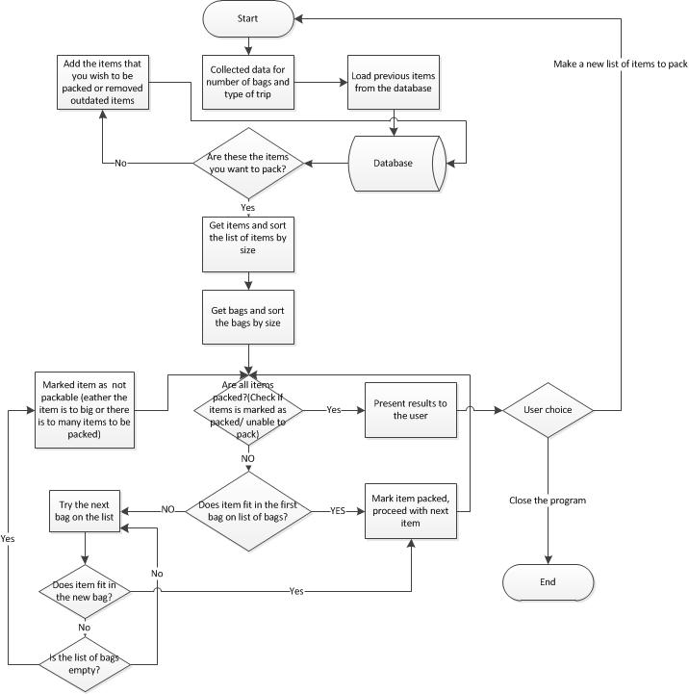
Design
Program planning
Flow of the program described in a diagram, see on figure 4
Figure 4: Diagram of the program
Notes:
Christian

Slide 9
Future plans
Work on implementing features on the program
Describing the different part of the program
Make a conclusion on the thesis statement
Notes:
Kasper

Slide 10
Team work
Roles in the group
Meeting culture
Responsibility for own learning
Funny time/ for the lulz/ giggles
Notes:
Dag

Slide 11
Thank you for your time
Source[1]: http://thewedordeadwager.files.wordpress.com/2011/03/luggage.jpg
Source[2]: http://www.cs.arizona.edu/icon/oddsends/bpack/bpack.htm
Notes:
Dag

